Slide 1
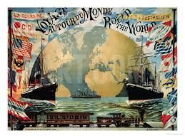

Slide 2
First Voyage around the World
Antonio Pigafetta

Slide 3
Outline of the Presentation
Background of the Author
Historical Background of the Document
Analysis of the important historical information found in the document
Contribution and relevance of the document in understanding the grand narrative of Phil. History
Relevance of the document

Slide 4
Background of the Author

Slide 5
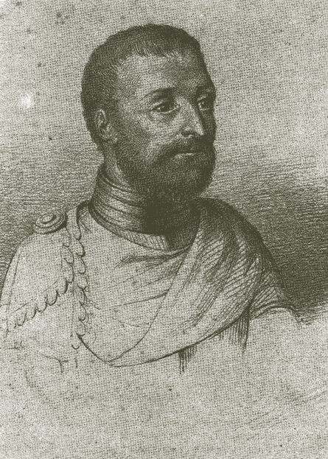
Antonio Pigafetta (1491– c.1534)
Born sometime in 1491 in Vicenza, a town about a hundred kilometers west of Venice, Italy.
Eldest son of Giovanni Pigafetta to second wife Angela Zoga.
Studied astronomy, geography and cartography
worked in the ships owned by the Knights of Rhodes.

Slide 6
Antonio Pigafetta (1491– c.1534)
Well educated young man, possessing avid curiosity of the world around him.*
Joined the delegation of Monsignor Francesco Chieregati when he was assigned as Papal Nuncio to Spain in 1519.
In the same year, he became acquainted with the lucrative spice trade and heard the news of the voyage to be undertaken by Ferdinand Magellan.

Slide 7
Antonio Pigafetta (1491– c.1534)
Presented his credentials to Magellan and to the Casa de la Contratacion, the office in charged of voyages to New World.
He was admitted as one of the sobresalientes (supernumeraries)*
Survived the challenges and catastrophes that the expedition encountered along the way and he even got wounded in the Battle of Mactan.

Slide 8
Antonio Pigafetta (1491– c.1534)
Returned to Spain on September 6, 1522 aboard the Victoria with Juan Sebastian Elcano and more than a dozen more survivors.
Presented himself to Charles V (now Holy Roman Emperor), a book written by his own hand, in which were set down the things that happened from day to day during their voyage.

Slide 9
Antonio Pigafetta (1491– c.1534)
Now known as Magellan's Voyage. A Narrative Account of the First Circumnavigation, a detailed tale of exploration and exotica.
Emperor Charles was apparently not impressed, and Pigafetta received no honor beyond his wages.

Slide 10
Antonio Pigafetta (1491– c.1534)
On his way home he passed by Portugal and France and shared to the people the things he knew about Magellan’s expedition.
In Italy the Pope was impressed enough to give him residence while he prepared his manuscript for publication.
*Joined the Knights of St. John of Jerusalem in its battle against the Turks.
Died sometime in 1534.

Slide 11
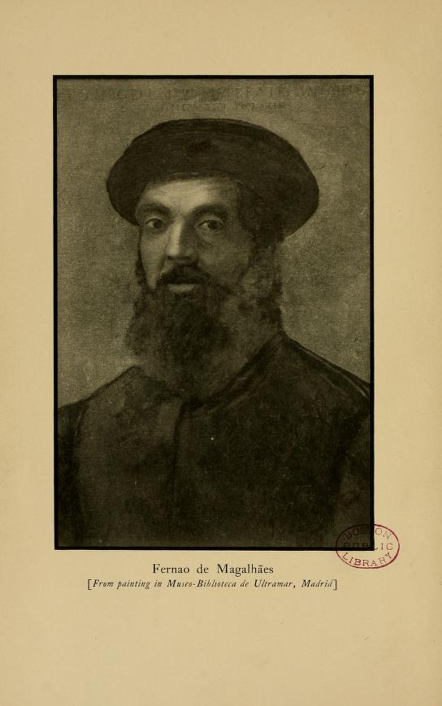
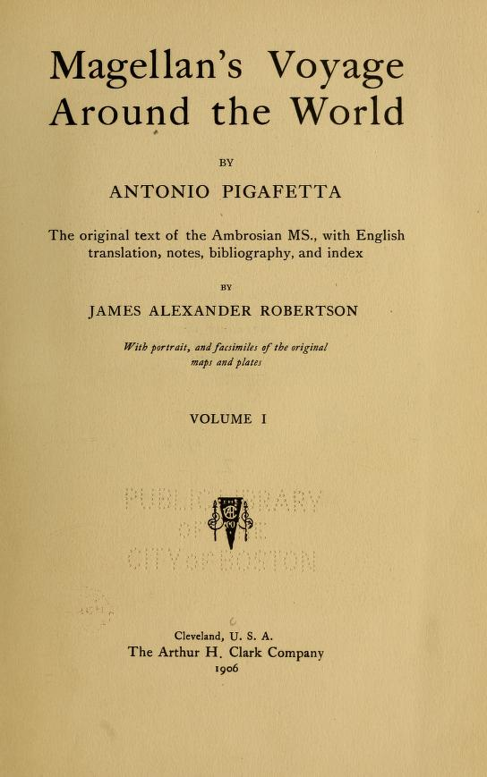

Slide 12
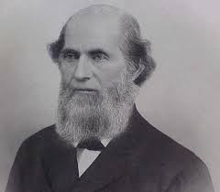
James Alexander Robertson
Born 1873 in Corry, Pennsylvania.
Sixth of eight children born to Canadian parents, John McGregor Robertson and Elizabeth Borrowman Robertson, who became naturalized U.S. citizens after relocating to Corry in 1866.

Slide 13
James Alexander Robertson
1923: Gained a position as professor at Stetson University in DeLand, Florida, and lectured there for the next ten years.
1935: Moved to Annapolis, Maryland as the archivist for the Maryland State Archives' Hall of Records.
1902: Robertson became involved in the compilation of a massive multivolume work on the history of the Philippines, initially called The Philippine Islands, 1493-1803.

Slide 14
Historical Context of the Document

Slide 15
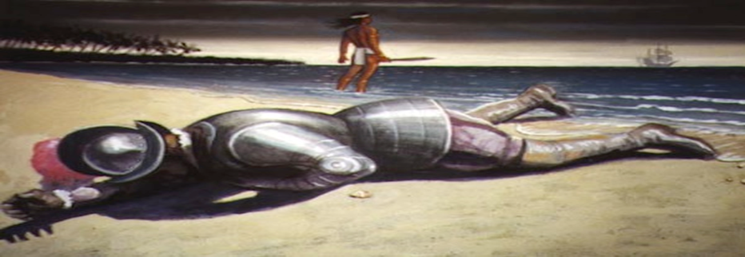
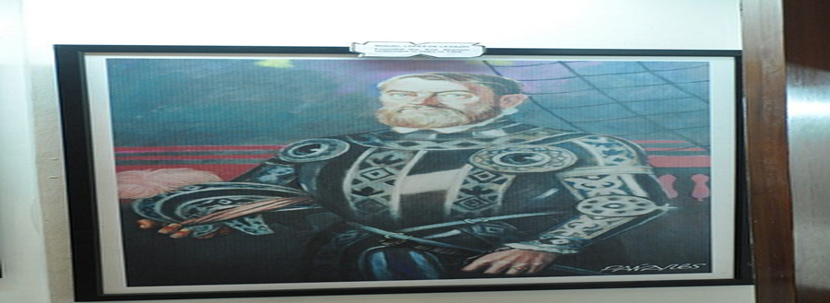
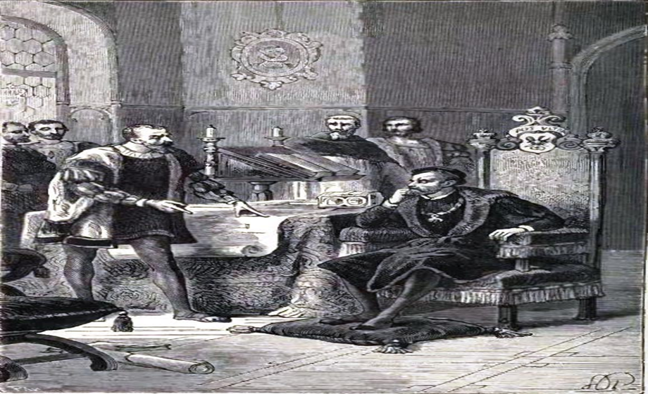
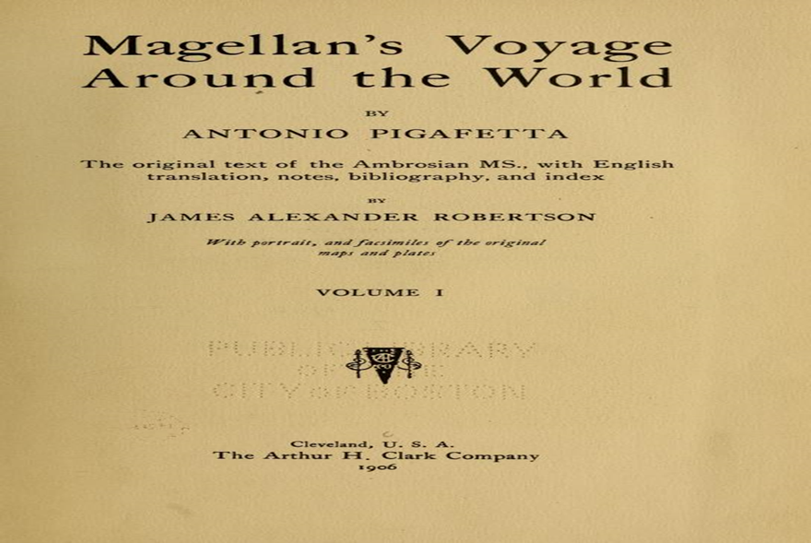
Ferdinand Magellan
Antonio Pigafetta
King Charles V

Slide 16
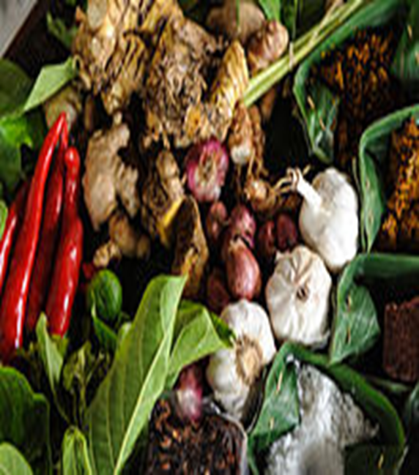
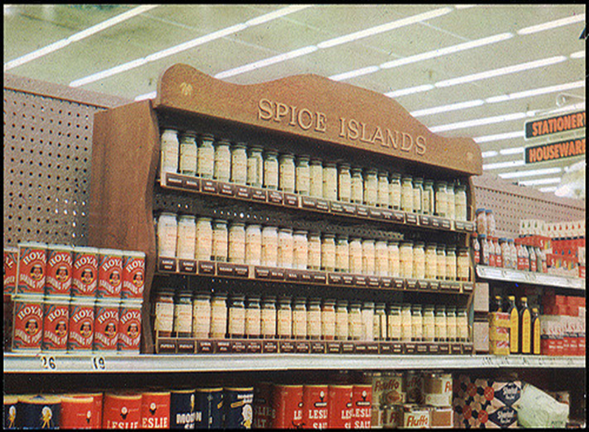
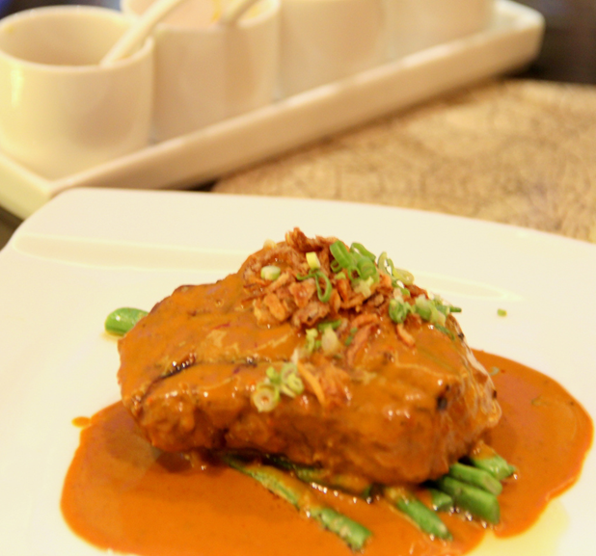
Spices became the most expensive and in demand commodity among Europeans because of their numerous uses. Originally, they used them to preserve foods and keep them from spoiling. Later they found out that spices have medicinal uses and may also be used for flavoring, coloring and as food additives.
Since it was a very lucrative commodity, many merchants aspired to monopolize its supply and distribution in the European markets.

Slide 17
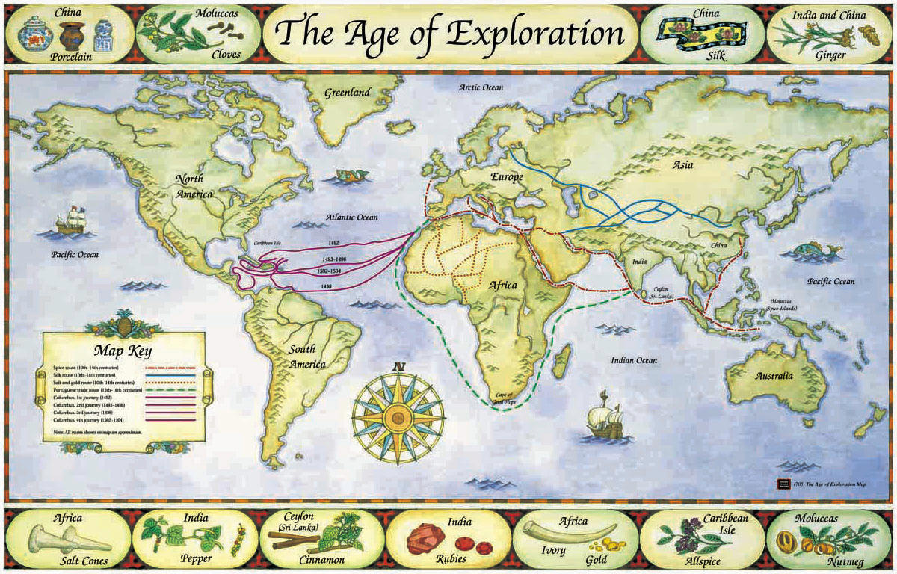
Asian goods reached Europe either via the Silk Road or the Arabian-Italian trade route. Both are expensive and oftentimes disrupted by wars and natural calamities.
Since land routes were expensive and required consent of many powerful armed groups, Portugal explored the ocean as alternative way to the Spice Islands. Prince Henry the Navigator of Portugal put up a maritime school that trained sailors who would later discover a sea route going to Southeast Asia via the Atlantic and Indian Ocean. This route enabled them to trade directly with the producers of spices and other oriental goods.

Slide 18
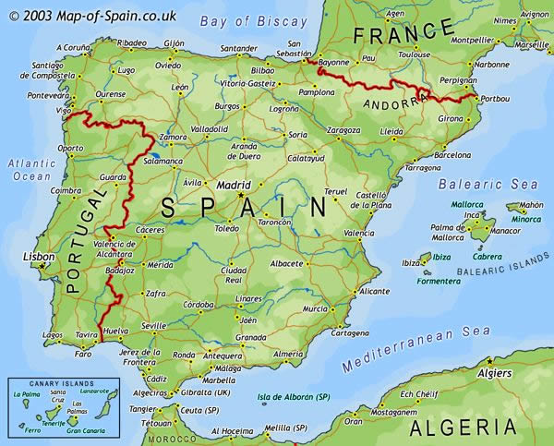
The rivalry between Spain and Portugal in the Iberian Peninsula was exacerbated by trade as both were interested in exploring and developing trade.
Both were located in ideal places to start exploring Africa and to start thinking about trying to round Africa and find a way to the Spice Islands in Asia.
The competition between Spain and Portugal became heated enough that the two countries had to get the pope to divide up the New World into parts that would be Spanish and parts that would be Portuguese.

Slide 19
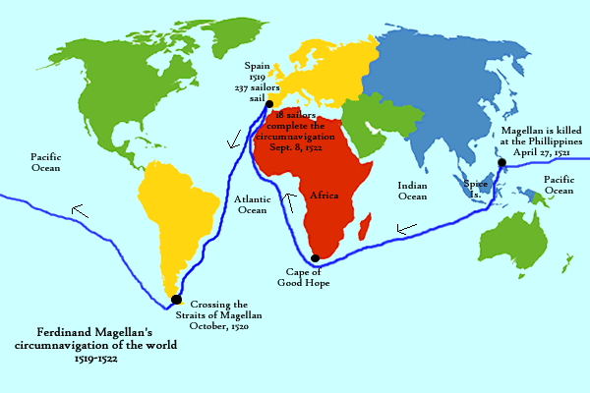
The Royal Crown of Spain supported the plan of Ferdinand Magellan to go to the east by sailing westward, a proposal that was not supported by Portugal.
Along the way the expedition suffered natural and man-made challenges and out of the five ships that left Spain only three reached the Philippines.
Magellan’s voyage was instrumental in introducing Christianity in the Philippines but it also cost his life after the Spaniards lost in the Battle of Mactan.
With only two ships, the survivors of Magellan were able to reach the Spice Island and on September 7, 1522, Juan Sebastian Elcano and 17 more mighty survivors arrived in Spain aboard the ship Victoria.

Slide 20
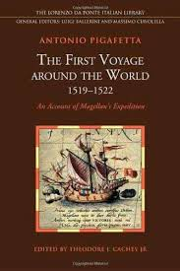
About the book…
Antonio Pigafetta was one of the survivors who kept a journal that became the main source about the first encounter of the Spaniards and the Filipinos.
The original journal of Pigafetta did not survive in history and what was handed down to us are copies of the manuscript that never came out of the press during his life time.
Three of them were in French and two are kept in the Bibliotheque Nationale in Paris.
The third one was originally owned by the British Collector Sir Thomas Phillipp.
Later, Beinecke Rare Book bought it and it is now kept in the Manuscript Library of Yale University in New Haven.

Slide 21
About the book…
The fourth copy was written in mixed Italian, Spanish and Venetian language and could be found in Ambrosian Library in Milan.
In 1800, Carlo Amoretti published an Italian version of it and the following year a French version came out in Paris.
Pinkerton of his part translated it to English and published it in 1819.
James A. Richardson made his own English version of the Ambrosian copy and it appeared in The Philippine Islands.
This is the copy the is widely circulated in the Philippines.

Slide 22
About the book…
Pigafetta’s travelogue contributed immensely to the enrichment of Philippine historiography.
His writing described vividly the physical appearance, social life, religious beliefs and cultural practices of the people they encountered in the islands of Samar, Leyte and Cebu.
His account also contains information about the economic activities of the local folks and the goods they offered for trade.
He got all this information through the help Enrique de Malaccca, Magellan’s slave/interpreter.
Lastly, Pigafetta gave us an eyewitness account of the Battle of Mactan which resulted to the death of Magellan and him getting wounded.

Slide 23
ANALYSIS of the Important HISTORICAL INFORMATION
ROMULO ‘IKIR’ LANUGAN

Slide 24
Introduction
All information that can be gleaned from the account of Antonio Pigafetta in his book, “ First Voyage Around the World” is written from the perspective of the writer/author who is a European (Italian in particular) and therefore a view from the outsider and it should be understood in the context of the time. Some descriptions of our ancestors; the way the treat visitors, their homes, their customs and traditions, foods, and others, are explicitly described and others are not for these are new to the knowledge of the colonizers. For this, one should be careful for some of these information are described in a way that it needs to be analyzed using both perspectives, European and our own (i.e. words and terminologies). Furthermore, for it is more fitting, that the “pantayong pananaw” is employed for the presentation of the analysis.

Slide 25
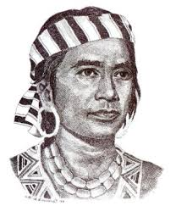
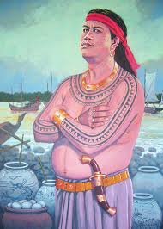
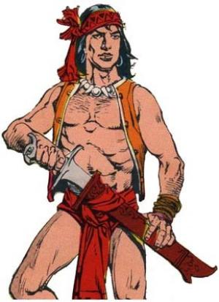
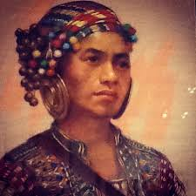
Personal Touch! (Important personages cited in the document)
Ferdinand Magellan (Portugese – Fernao de Magalhaes) – captain-general (leader) of the expedition
Antonio Pigafetta (Italian) – official chronicler of the expedition
Raia Colambu (Raja Kulambu) – king of Mazaua (Limasawa)
Raia Siaui (Raja Siagu) – king of Butuan
Raia Humabon – king of Zubu (Cebu)
Raia Cilapulapu and Raia Zula - chiefs (kings) of Matan (Mactan)

Slide 26
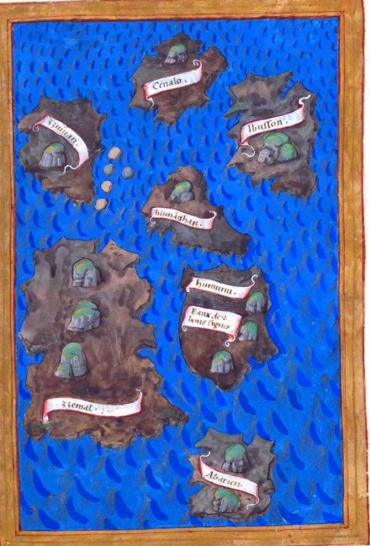
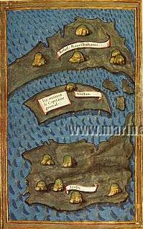
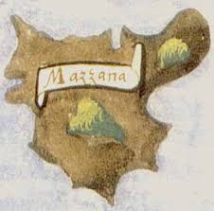
Latitudes and Leagues! (Geographical Position of the Islands)
Zamal – three hundred leagues from the islands of Ladroni
Mazaua – (latitude) nine (degrees) and two-thirds degrees toward the Arctic Pole, (longitude) one hundred and sixty-two degrees from the line of demarcation, and twenty-five leagues from the Acquada (Humunu-Homonhon)
Twenty leagues from Mazaua to Gatighan
Fifteen leagues from Gatighan to Zubu (Cebu)

Slide 27
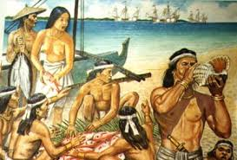
Of Suns, Moons and Bloods! (Chronology of Dates)
March 16, 1521 (dawn of Saturday) –
the Spanish colonizers arrived at Zamal
(Samar) [no need to add one day for this
is not yet covered by the International
Date Line]
March 17, 1521 – their captain-general
desired to land at Humunu (Homonhon)
and which he named, Acquada da li buoni
Segnialli (“the Watering-place of Good Signs) and later the entire group of
island as Archepalago of St. Lazaro
March 18, 1521 – they met and exchanged goods with our ancestor from the island of Zuluan
March 25, 1521 – they weight anchored and changed course toward west southwest
March 28, 1521, they anchored near the island of Mazaua (Limasawa) and they met the king who came in balanghai

Slide 28
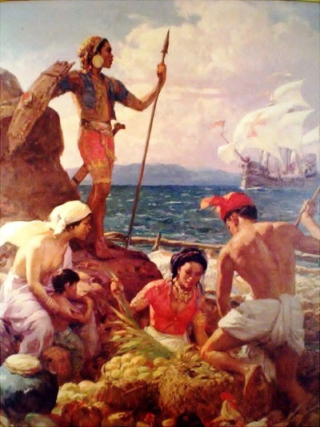
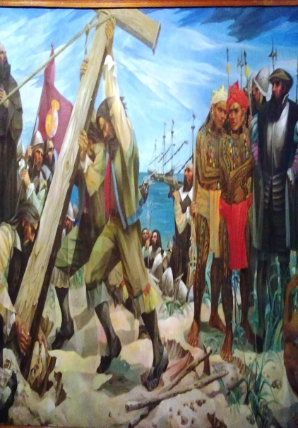
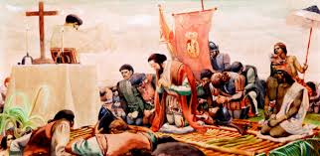
Of Suns, Moons and Bloods!...
March 29, 1521 (Holy Friday) – they finally met the king who entered their ship
March 31, 1521 (Easter Sunday) – they went ashore to say mass and set up cross on the summit of the mountain
April 7, 1521 (Sunday) – they entered the port of Zubu (Cebu)
Monday – their notary together with their interpreter went ashore to met with the king of Zubu
Tuesday – the king of Mazaua and later the prince of Zubu went aboard their ship
Wednesday – they consecrated the place and buried their two dead crews

Slide 29
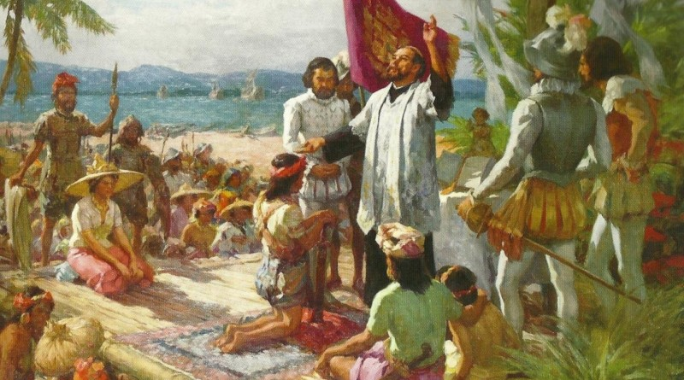
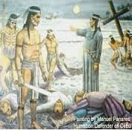
Of Suns, Moons and Bloods!...
Friday – they showed our ancestors with different merchandise
April 14, 1521 (Sunday) – they baptized our ancestors from Zubu and few from neighboring islands
April 26, 1521 (Friday) – Raia Zula came to seek help to fight the other chief of Matan, Cilapulapu
April 27, 1521 (Saturday) – the Spaniards wave ashore in the island of Matan and fighting commenced between them and men of Raia Cilapulapu and led to the death of Magallanes
May 1, 1521 (Wednesday) – 21 Spaniards were massacred by the Zubuanos thus forcing the remaining Spaniards to depart Zubu immediately

Slide 30
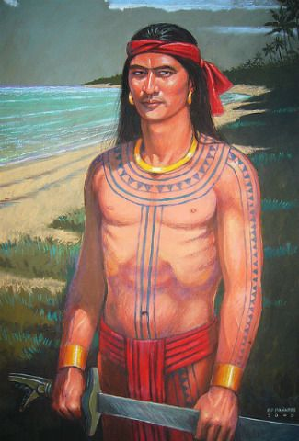
Are We the Same? (Descriptions of Our Ancestors)
Seignior (king/chief)
Matured (old man in some encounters)
Some are bit larger than his men and the finest looking man
Some are painted (tattooed)
Wore gold earrings
Some have black hair and hung to shoulders
Head covered with silk (kerchiefs)
Wore cotton cloth all embroidered with silk which covered him from the waist to the knees
Some have spots of gold on every tooth
Some are perfumed with storax and benzoin
Wore armlets and other rings for the feet
Wore necklace of great value

Slide 31
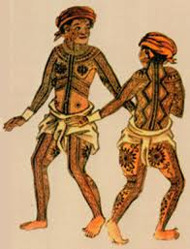
Our Ancestors…
Others (men)
Naked, with cloth woven from a bark of a tree about (cover) their privies
Dark, fat and painted (tattooed)
Anointed with their bodies with coconut and beneseed oil as a protection against sun and wind
Some have dark hair that hung to the waist
Have their penises pierced from one side to the other near the head with a gold or tin bolt as large as a goose quill.

Slide 32
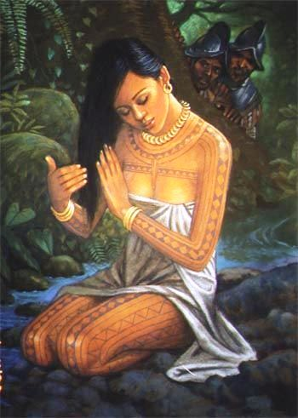
Our Ancestors…
Others (Women)
Clad in tree cloth from waist down
Hair is black and reaches the ground
They are as white and as large as the Spaniards
Holes on their ears which are filled with gold (earrings)
Constantly chewing a fruit which they call areca which resembles a pear, cut into four and wrapped with betre (betel) leaves
Women age six upward have their vaginas gradually opened because of the men’s penises

Slide 33
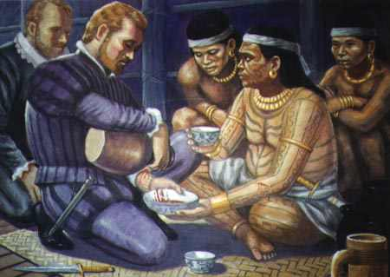
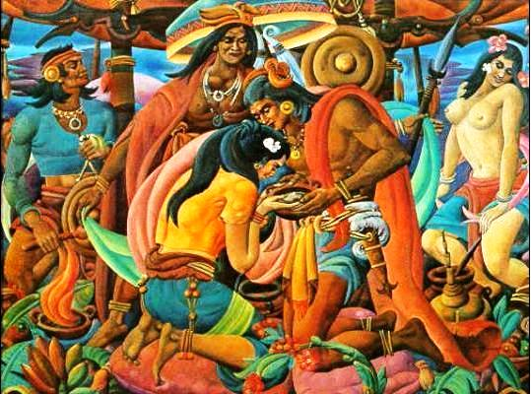
The Cultural Milieu (Customs, Traditions and more…)
Thanksgiving/Gratitude
Raised clasped hands and face towards the sky and then turned to others
Friendship (casi-casi)
A ritual of friendship wherein one has to shed a drop of his blood from his right arm and the other will do the same and partake each others’ blood
Marriage
One can have many wives as they wish but one of them is the principal wife

Slide 34
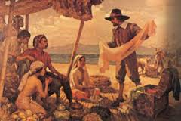
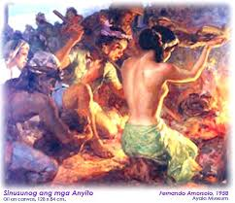
Customs,Traditions and more…
Trade
Our ancestor have a custom that all ships that will enter their port should pay tribute
Festivities
Our ancestor are heavy drinkers
Before the king drinks, he raised his clasped hands towards the sky and then towards the person he is drinking with and the former extends his fist of the left hand towards the latter
Sometimes they have a meal that would last for six hours

Slide 35
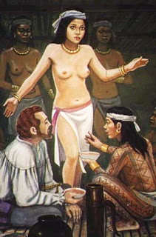
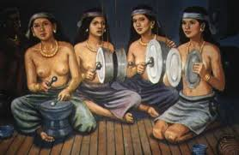
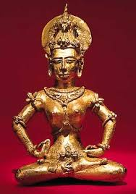
Customs, Traditions and more…
Entertainment
Our ancestor played musical instruments like drums, metallic discs, gongs and bells
Also, our ancestors can dance
Religion
Our ancestors don’t have formal religion but they have God which they call “Abba”
Although, no religion they have idols made of wood, hollow and lack of back parts

Slide 36
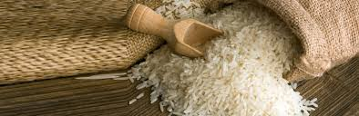
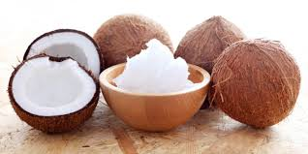
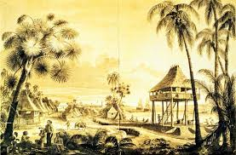
Customs and Tradition and more…
Food
Our ancestors eat umay (rice), coconut, meat and fish, and drink uraca (arrack) – a wine taken from palm (coconut)
Animals and Other Produce
Dogs, cats, swine, fowls, goats, rice, ginger, coconuts, figs (banana), oranges, lemons, millet, panicum, sorgo, wax and gold
Dwellings
Built up from the ground on huge posts of wood and thatched with fig and palm leaves

Slide 37
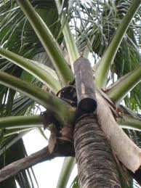
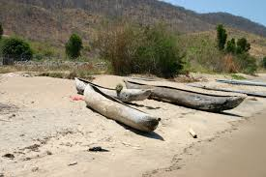
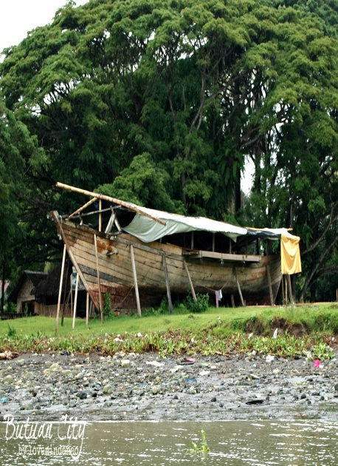
Word Game! (Terminologies)
uraca (arrack) – palm wine, this resembles tuba at present
(h)umay – rice
caphri – heathen
anime – a gum of a tree wrapped in palm or fig (banana) leaves for lights
baloto – small boat
balanghai – big boat (resembles fusta in Spanish)
aghon – gongs (resembles bells in Spanish)
laghan – a large sea snails which kills whales by eating whale’s heart

Slide 38
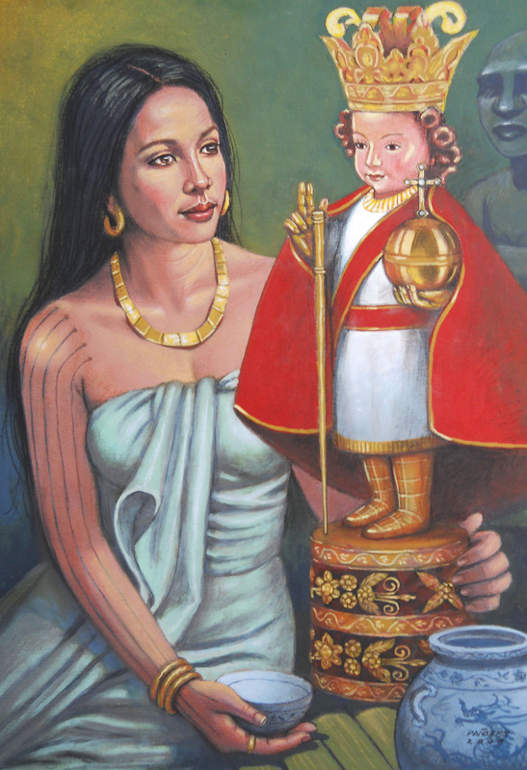
What’s in a name? (Christian Names given to our Ancestors)
Conversion of our Ancestors
Raia Humabon – Don Carlos
Son of Raia Humabon (prince) – Fernando
Raia Culambo – Johanni
A Muslim - Christoforo
Queen (Amihan) – Johanna
her daughter (wife of the Prince) - Catherina
Queen of Mazaua - Lisabeta

Slide 39
Contribution and RELEVANCE
OF
PIGAFETTA’s DOCUMENT

Slide 40
On Geography
The Pigafetta document gave a detailed chronicle of the significant events of the exploration of Ferdinand Magellan.
It provided a description, location and distances of the places visited thereby enhancing the knowledge of cartography at that time.
The chronicle contributed immensely to European historiography because it preserved and popularized the achievements of the Magellan-Elcano expedition.

Slide 41
On Economics and Trade
There was an evidence of agricultural activities based on their produce.
They engaged in trade with neighboring countries such as China.

Slide 42
On arts, customs, traditions and religion
As described, Filipinos have their unique musical instruments;
They have arts as seen in their bodies being tattooed (in some villages);
Performed rituals during dining and some gatherings;
They have a lot of burial practices;
Worship of anitos (wooden idols) and ritual for healing of ill persons.

Slide 43
On the other hand, the document also narrated the status (inferiority) of the Filipinos in some ways such as;
Warfare - weapons
Manner of dressing
System of writing

Slide 44
On Christianization
The documents narrated the conversion of early Filipinos into Christianity

Slide 45
at present…..
textbook writers use his book as their source of historical information every time they discuss the beginning of Christianity in the Philippines. Their accounts about the first mass in the Philippines, the conversion of Rajah Humabon and his wife and the story of the image of the Sto. Nino were mostly taken from Pigafetta’s book.

Slide 46
Daghang Kaayong Salamat! Madamo nga Salamat! Maraming Salamat po!

